Slide 1


Digital Directions
Client & Project Portal
Team Overview & Future Roadmap
February 2026

Slide 2




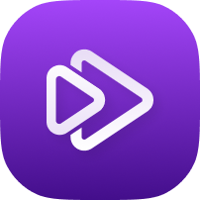
What We'll Cover
Why We Built the Portal
01
The problem and our solution
How It Works Today
02
Live features, Digi AI, support workflow, and security approach
CSAT Impact
03
How the portal affects implementation quality scores
Future Vision
04
File sharing, ticketing in-portal, and implementation team access

Slide 3

The Challenge
1
Clients constantly asking "where are we?" — most questions are just status requests
2
No single source of truth for project status or implementation progress
The Solution
3
Support requests tracked informally with no structured workflow
A self-service portal that answers client questions before they need to ask — reducing back-and-forth and giving everyone real-time visibility into project progress.
4
Integration health issues discovered reactively instead of proactively
4 integrations monitored
every 5 min, 24/7
5
Implementation quality hard to measure or improve consistently

Slide 4




Two Portals, One Platform
Admin Portal
Client Portal
For the DD Team
For Our Clients
Manage all clients & projects
View project progress & phases
Configure project lifecycle phases
See integration health status
Set up integration monitors
Chat with Digi AI for quick answers
Invite new portal users
Get directed to support when needed
View client engagement & activity
In-app notifications on updates

Slide 5
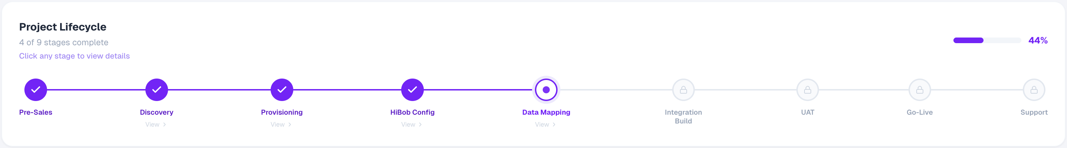
Project Lifecycle
HiBob-to-Payroll integration projects follow a structured 9-stage journey
1
2
3
4
5
6
7
8
9
Pre-Sales
Discovery
Provisioning
HiBob Config
Data Mapping
Integration
Build
UAT
Go-Live
Support
This lifecycle currently covers HiBob-to-payroll integrations. In the future, it could be expanded to unify the full implementation journey across all project types.

Slide 6
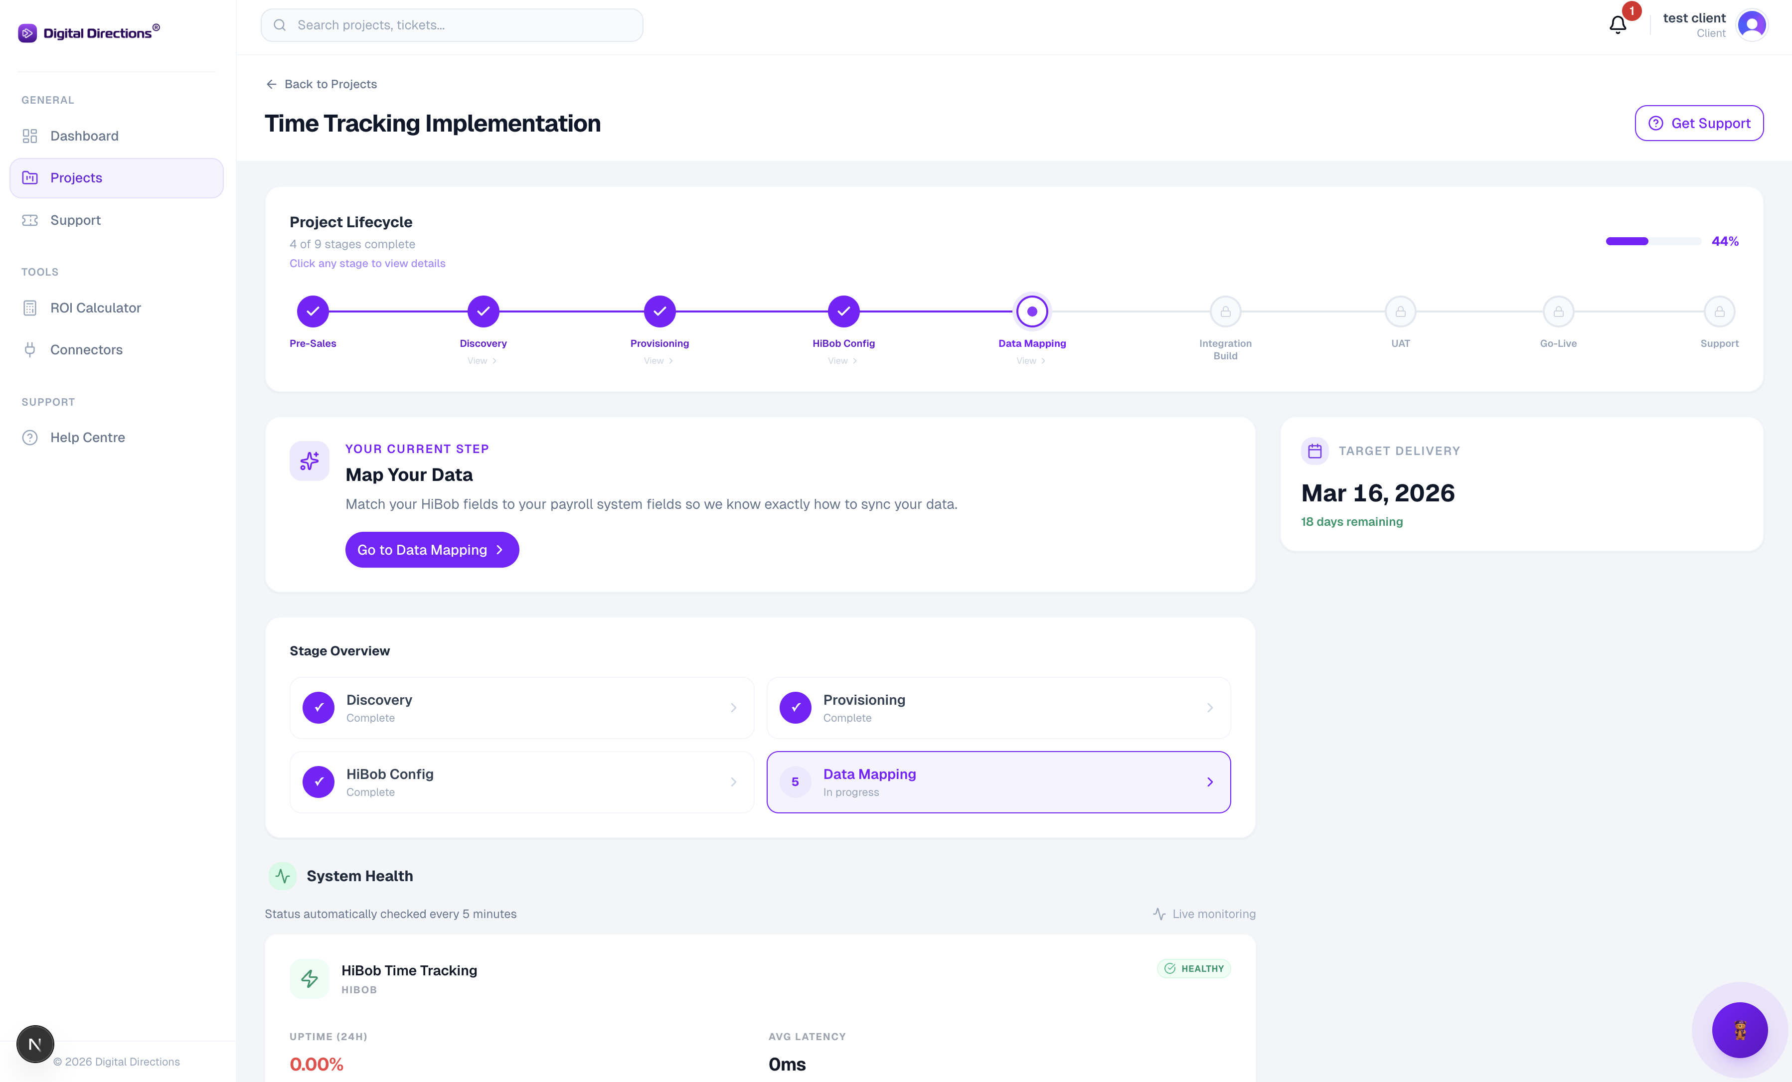
Project Management
Phase Templates
Reusable templates ensure consistent processes across every engagement
Custom Phases
Add project-specific phases beyond the standard template when needed
Status Tracking
Pending → In Progress → Completed — with timestamps at each transition
Multi-Project
Each client can have multiple projects running simultaneously

Slide 7

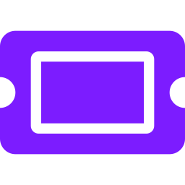



How Support Works Today
The portal guides clients to our support email. From there, Freshdesk handles the workflow.
Portal tells client
to email support
Email creates a
Freshdesk ticket
Slack notification
alerts the DD team
DD resolves the
ticket in Freshdesk
Digi AI: Ticket Deflection
Before clients reach for email, Digi can answer common questions about their project status and next steps — reducing ticket volume for simple queries.

Slide 8

Integration Monitoring
Live health checks running every 5 minutes for all client integrations
HiBob
KeyPay
Workato
NetSuite
Healthy
Healthy
Monitoring
Healthy
Alert System
When an integration goes down or degrades, the system automatically:
Sends an email notification to the affected client
Creates in-app notifications visible in the portal
Logs historical metrics for trend analysis
Anti-flapping protection prevents alert fatigue

Slide 9
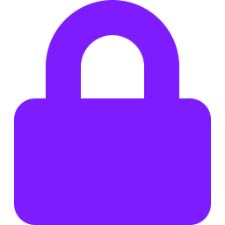
Security-First Approach
Some features are intentionally excluded from the current portal to meet security compliance requirements. These are candidates for future implementation once compliance is addressed.
LIVE IN THE PORTAL
FUTURE (COMPLIANCE-GATED)
✓ Project lifecycle tracking & phases
→ File sharing within the portal
✓ Integration health monitoring
→ Direct messaging between DD & clients
✓ Client self-service via Digi AI
→ In-portal ticket management
✓ In-app notifications
→ Support hour tracking & time logging
✓ Role-based access control
→ Implementation team portal access
Security compliance drives what goes into the portal and when

Slide 10
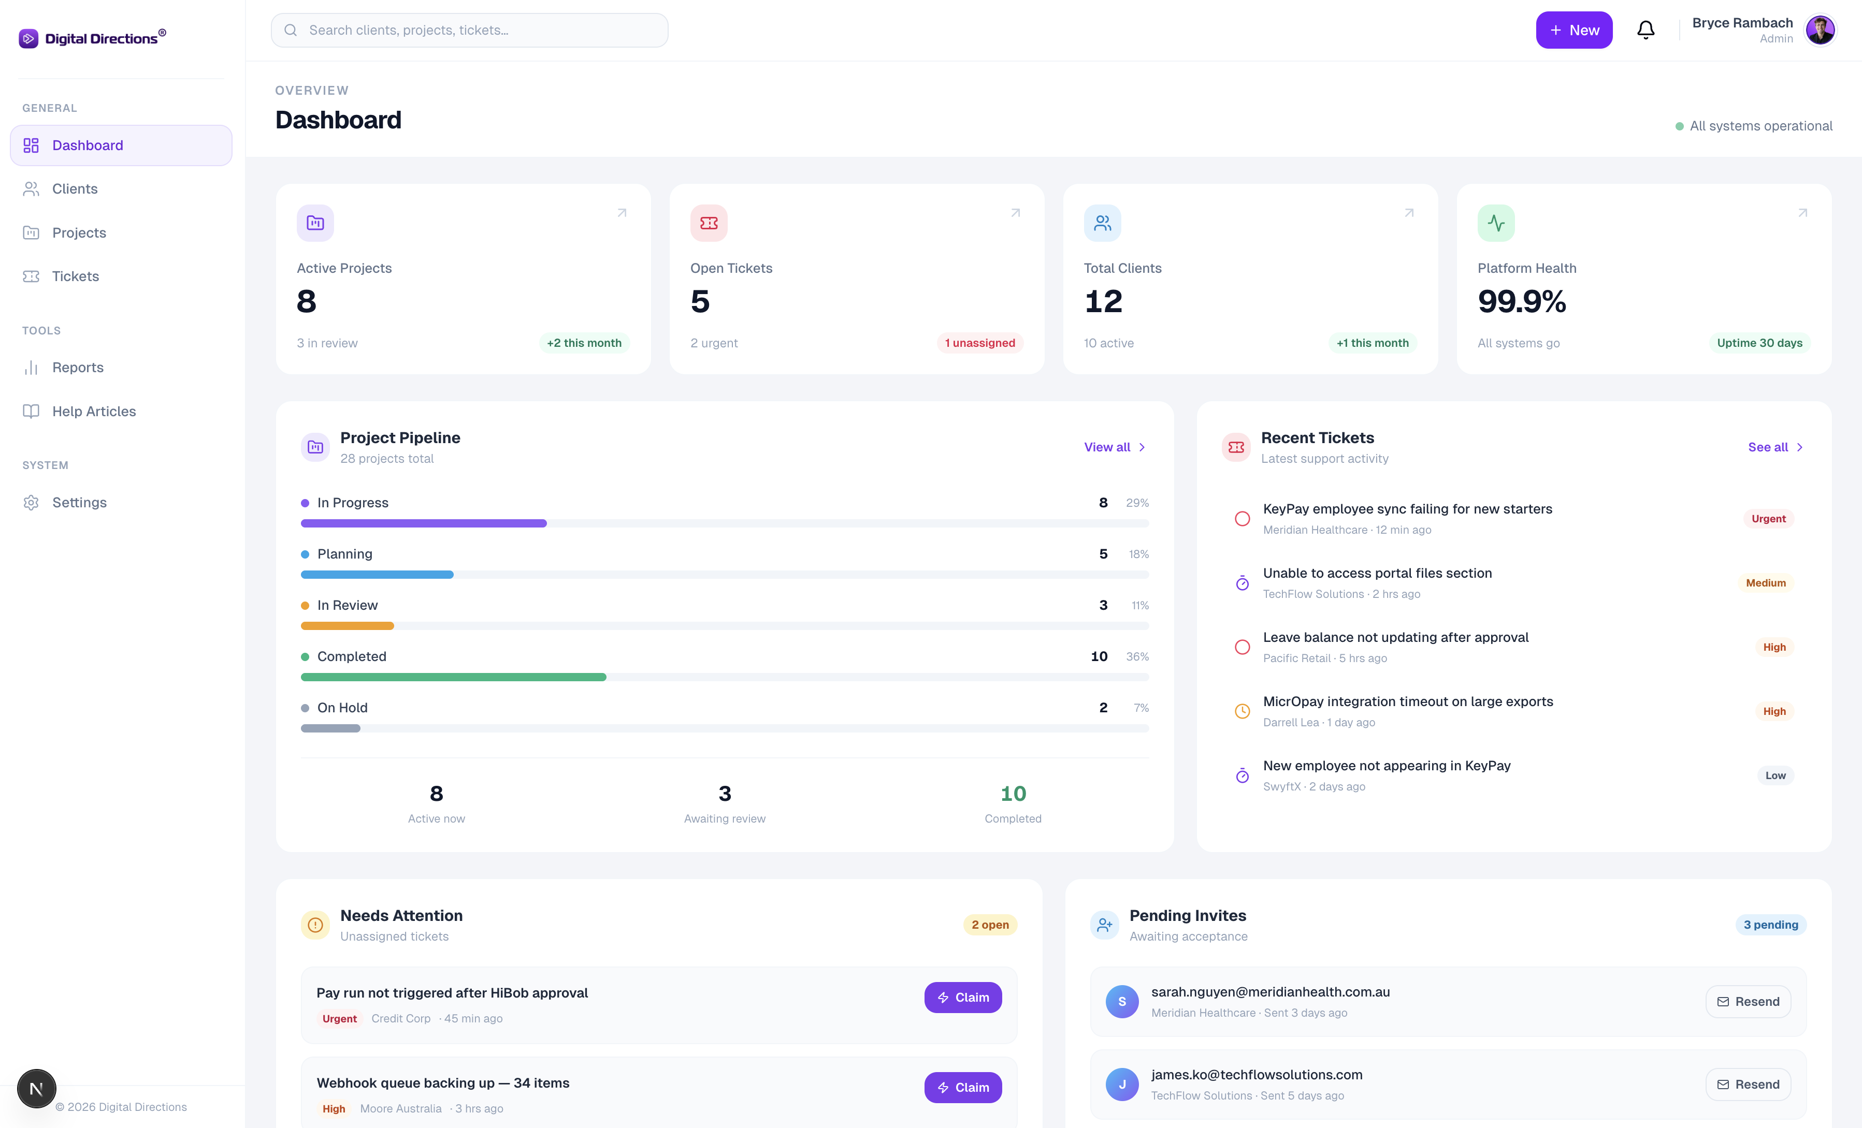
Admin Dashboard
Full overview of clients, projects, and activity at a glance

Slide 11
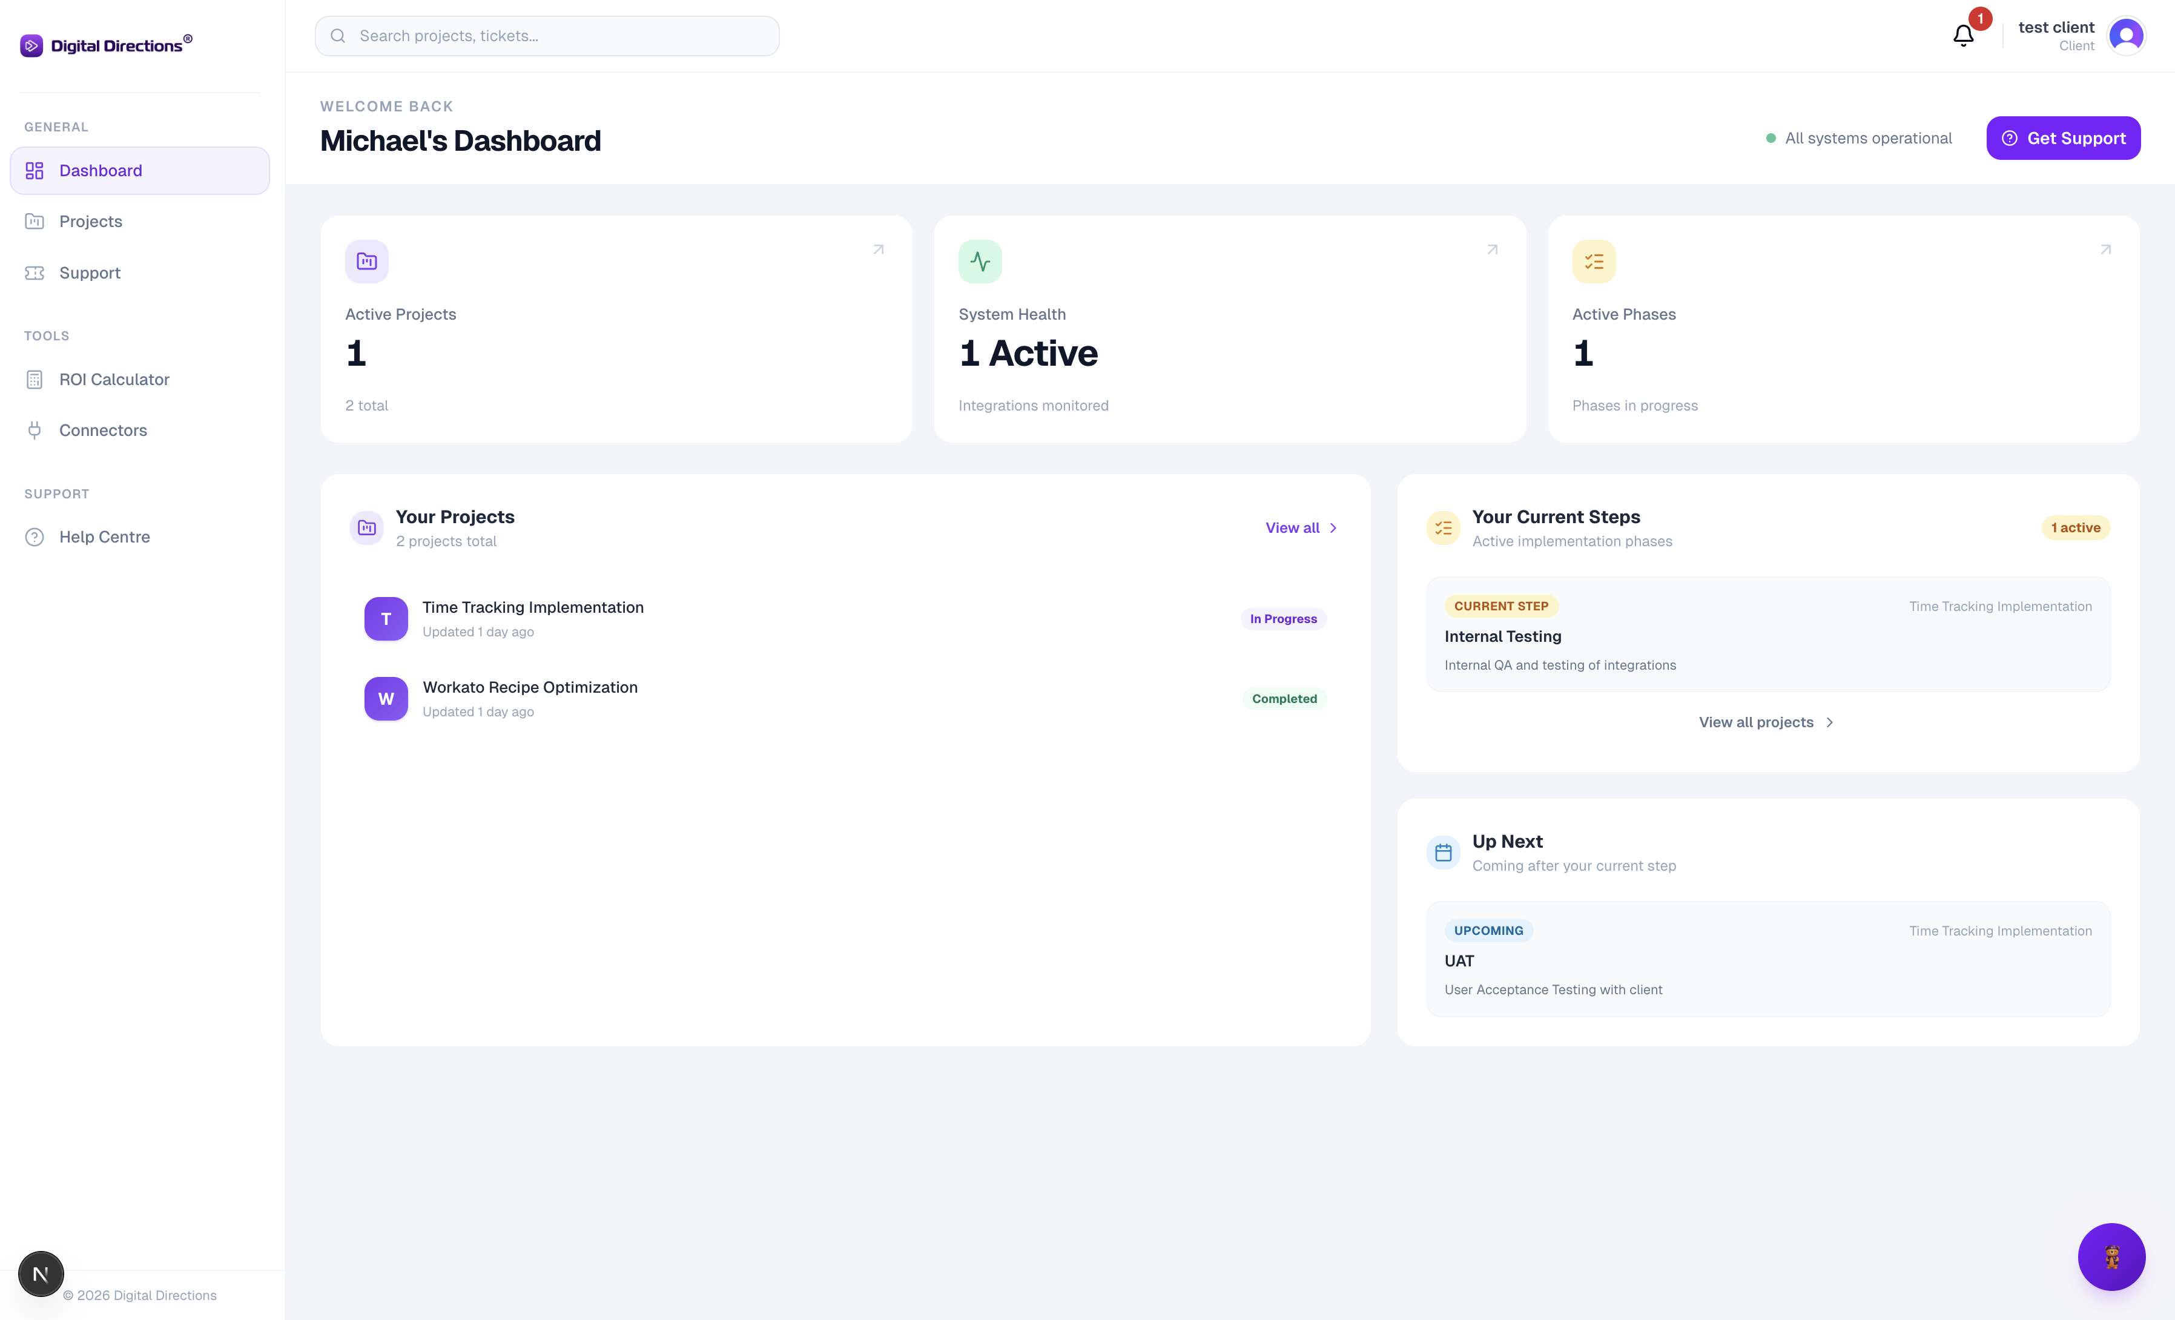
Client View
What your clients see when they log in — clean, focused, and informative

Slide 12

How the Portal
Impacts CSAT
Understanding the connection between our processes and client satisfaction scores

Slide 13



How the Portal Drives Higher CSAT
Our processes directly affect the CSAT scores the implementation team receives. Every touchpoint contributes to how clients rate the experience.
Self-Service Answers
Proactive Monitoring
Clients find answers in the portal instead of emailing — fewer "where are we?" questions
Integration alerts catch issues before clients even notice them
Transparency
AI-Powered Support
Real-time project progress visible to clients — no status update meetings needed
Digi chatbot gives instant responses, reducing wait times for common questions
Professionalism
Consistency
Branded portal experience signals maturity and builds client confidence
Phase templates ensure every client gets the same high-quality process

Slide 14
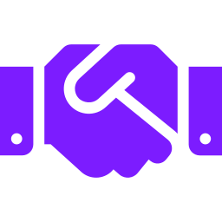
What This Means for Us
Beyond what clients see — here's how the portal makes our day-to-day easier.
Fewer repetitive status emails
Less Slack noise
Clients can check progress themselves — less "where are we?" in your inbox
Structured alerts replace ad-hoc pings. Integration issues surface automatically.
Clearer handoffs
Fewer surprise integration failures
Everyone sees the same project phases and status — no more guessing what stage we're at
Health monitoring catches issues before clients notice — less firefighting for us
More predictable implementations
Digi handles the easy questions
Templates and lifecycle stages mean every project follows the same proven process
Common questions get answered instantly — the team only deals with the real issues

Slide 15
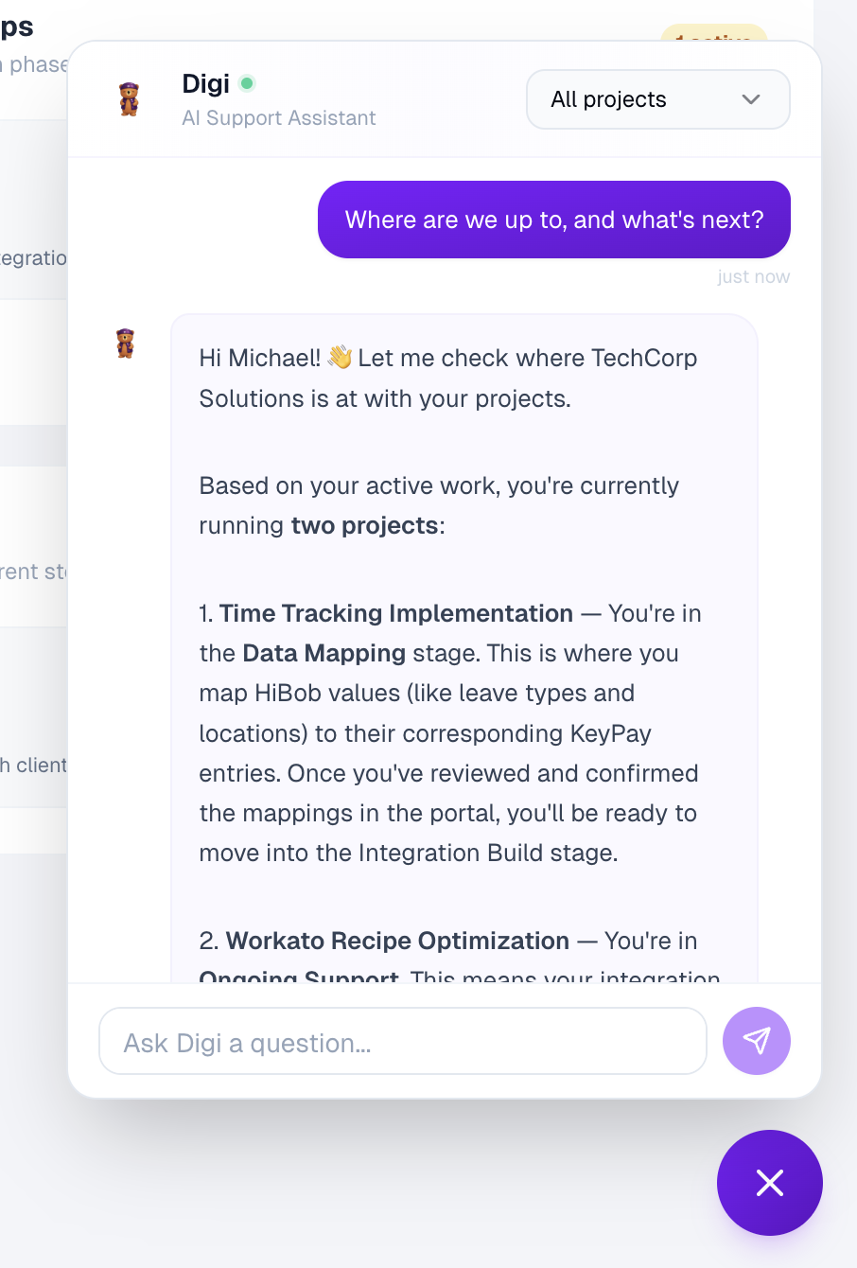
Meet Digi — Our AI Chatbot
LIVE
Digi is live in the portal as a first line of support. It handles common questions so clients don't need to email for basic status updates. Still improving, but already deflecting tickets.
Powered by Claude AI (Haiku model)
Context-aware: knows project, stage, and flags
Draws from knowledge base articles
Escalates to email → Freshdesk when needed
Adapts personality based on project state
Digi has 5 emotional states — see the next slide for how personality drives the experience

Slide 16




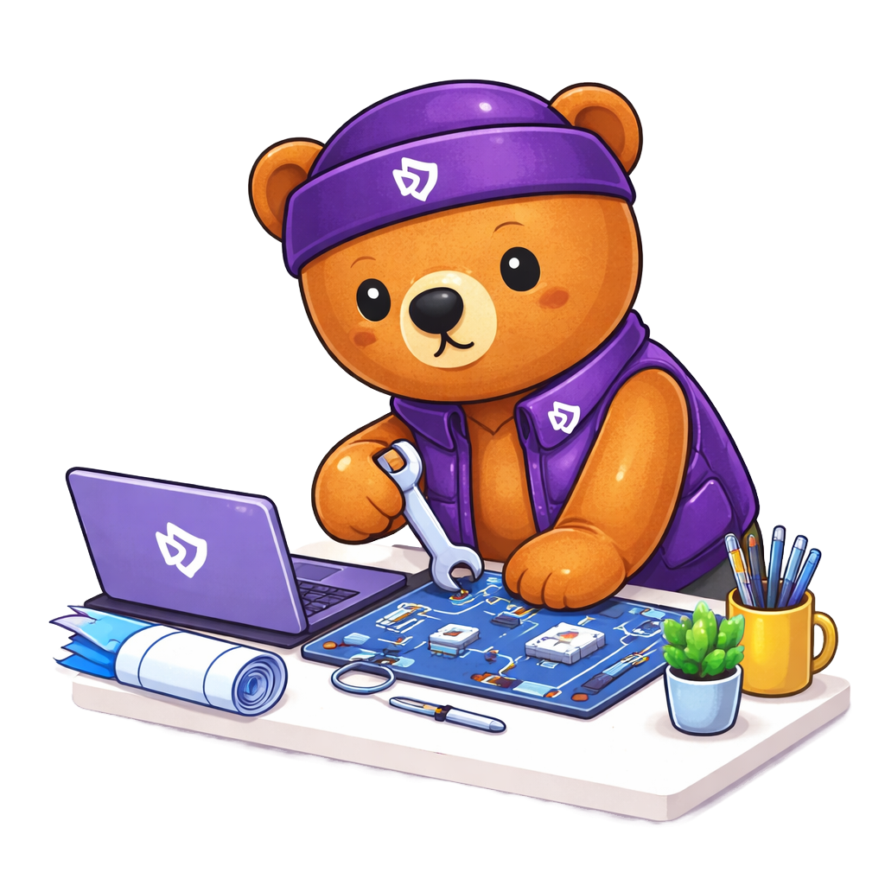
Digi's Personality States
Digi adapts its appearance and tone based on the client's project state — adding a personal, engaging touch to the support experience.
Neutral
Celebrating
Confused
Construction
Sleeping
Default state —
ready to help
Go-live achieved
or milestone hit
Something seems
off or unclear
Stage under
active build-out
Locked stage or
inactive project

Slide 17

Future Vision
What's next — once security compliance is addressed

Slide 18
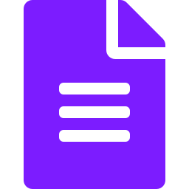

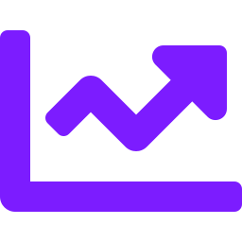
Compliance-Gated Features
These features are built and ready but require security compliance sign-off before going live.
File Sharing
In-Portal Ticketing
Secure document upload and organisation per project. Currently not meeting compliance requirements, but the infrastructure is in place.
Full ticket management inside the portal instead of routing through email and Freshdesk. Would give clients real-time ticket status visibility.
Project Messaging
Support Hours & Time Logging
Real-time messaging between DD and clients per project. Excluded due to confidentiality concerns, but could replace email threads.
Track monthly support hour allocations and automatically deduct time when resolving tickets. Integrates with the ticket system.

Slide 19

Why Include the Implementation Team?
End-to-End Visibility
Implementation consultants currently rely on secondhand updates. Direct portal access means real-time awareness of what DD is doing behind the scenes.
Shared Accountability
When both teams see the same project status, it's easier to coordinate handoffs and avoid duplicated effort.
CSAT Alignment
If CSAT depends on the full implementation experience, both DD and the implementation team need a shared view of progress and issues.
Faster Issue Resolution
Implementation consultants could flag blockers directly in the portal rather than routing through email chains.

Slide 20
Implementation Team Access
Currently the portal has two roles: Admin (DD) and Client. A third role — Consultant — could give the implementation team tailored access.
Admin
Consultant
Client
DD Staff
Implementation Team
Client Users
→ Full project management
→ View project status & phases
→ View own project progress
→ Client & user management
→ Raise flags & escalations
→ Chat with Digi AI
→ Integration configuration
→ View integration health
→ Get directed to support
→ Phase templates
→ Shared metrics dashboard
→ View integration health
→ All client activity
→ Read-only project access
→ Portal notifications
This is an idea — not a commitment. Would love your input on what would actually be useful.

Slide 21
What's Next — Roadmap
NOW
NEXT
FUTURE
Light mode UI revamp
Knowledge base expansion
File sharing (post-compliance)
9-stage lifecycle (payroll)
Expanded integration monitors
In-portal ticketing
Freshdesk integration
Unified lifecycle for all projects
Implementation team access

Slide 22
Key Takeaways
01
Clients can self-serve — Digi AI and the portal handle the "where are we?" questions.
02
Better processes = higher CSAT. The portal raises the bar on every interaction.
03
Security first — file sharing, messaging, and ticketing come after compliance.
04
Implementation team access could unify the full client experience.

Slide 23
Questions &
Discussion
→ What's missing from the portal that would help you?
→ What would make your role easier day-to-day?
→ Where does this break down or not fit your workflow?
Tell me now, or drop it in the Slack channel anytime.
February 2026

